Slide 1
Week 6
Network attack and defense

Slide 2
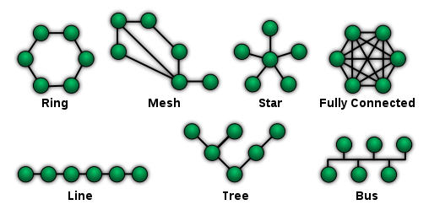
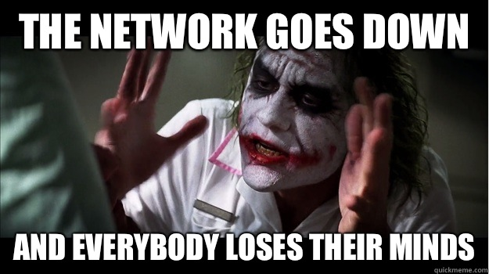
What is a network?
Nodes
Topologies
Packets
https://en.wikipedia.org/wiki/Network_topology#/media/File:NetworkTopologies.svg

Slide 3
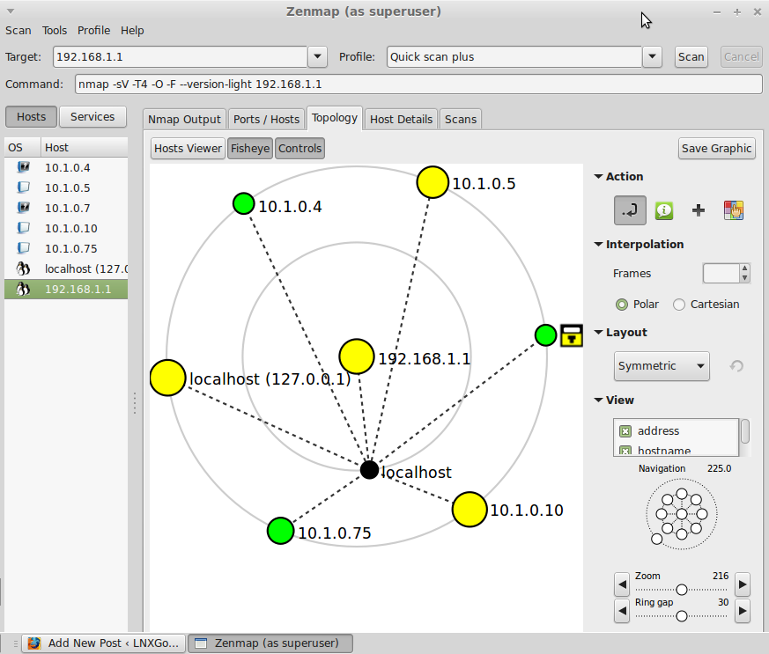
Network threats: Scanning
IP scan
Port scan
Network recon
Mapping
  Zenmap
https://nmap.org/zenmap/

Slide 4
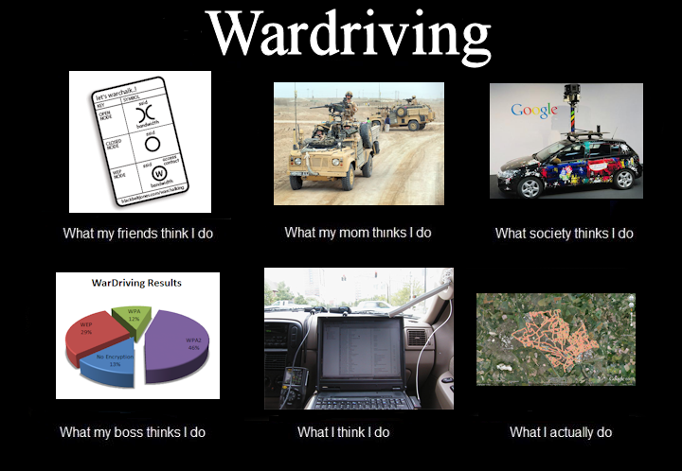
Network threats: Sniffing
Packet analysis
Encryption
Man in the Middle attacks
Wardriving
Demo: Wireshark
https://www.wireshark.org/

Slide 5

Network threats: Wireless
Scanning tools
Cracking tools
  Aircrack
  Reaver
Encryption types
  WEP
  WPA
  WPA2
  WPA3
Wifi broadcasting
  Demo airodump-ng

Slide 6
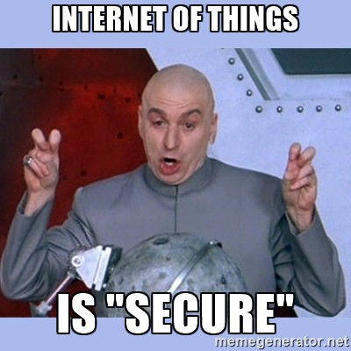
Network threats: Internet of Things
Bluetooth
PAN/BAN type of networks
Home automation
  Zigbee
  Nest
  Alexa

Slide 7
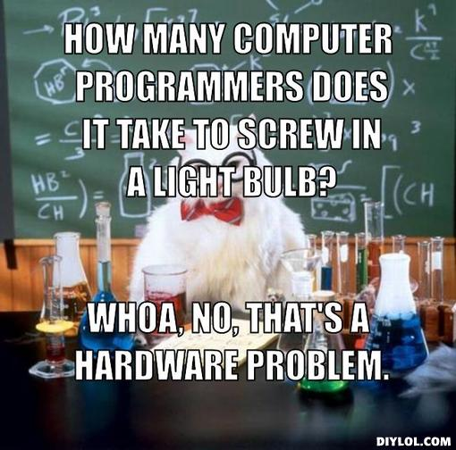
Network threats: Hardware
Vulnerable devices
  Routers
  Printers
Secure communications

Slide 8
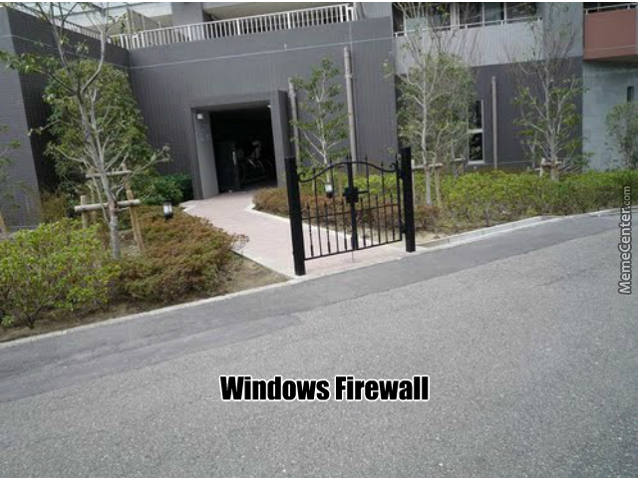
Oh noes! All is on fire!
Firewalls
  Network based
  Host based
  Packet vs application

Slide 9
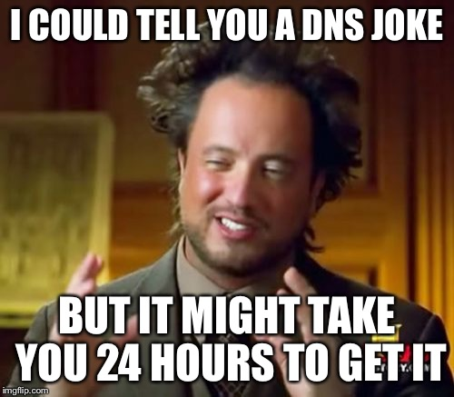
Network management: DNS
How does DNS work?
Authoritative vs nonauthoritative answers
DNS hijacking
  Ads
  Statistics
  Censorship
DNS caches
  DNS cache poisoning
DNSSEC
Split DNS

Slide 10
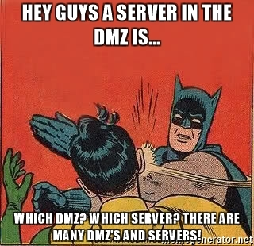
Network management: DMZ
Common services
  Web server
  Email server
  FTP server
  VoIP server

Slide 11
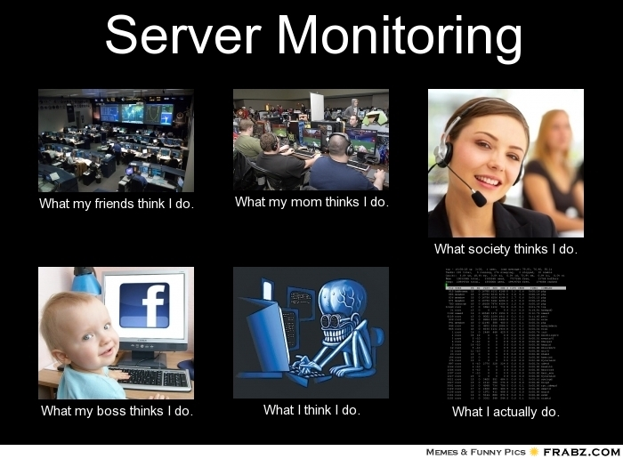
Network management: Monitoring
Testing
Network tomography (health of links)
Route analysis
Internal vs external
Example of software
Nagios

Slide 12
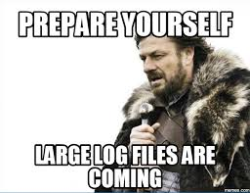
Network management: Logging
Log faults (application and system)
Log info (users, files etc)
Log integrity
  Dedicated Log servers
  Redundancy
Log review/audits
Log analysis
Forensics after the fact

Slide 13
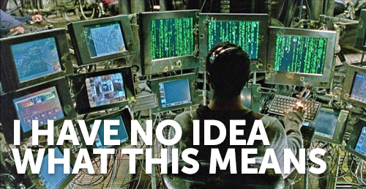
Network management: Red flags and false alarms
Allowlist vs denylist
False positive vs false negative

Slide 14
Allowlists and Denylists
Allowlist: only the things on the list are allowed
Denylist: everything is allowed except the things on the list
You'll still see whitelist and blacklist in older tools, documentation, and job postings. The industry is moving away from them because they tie white to good and black to bad, and the new terms say what the list does

